Slide 1

INSE 6290 AI-Based Demand Forecasting & Inventory Optimization
Prepared By :Group 02
Student Names | Student ID
Md Golam Raiyhan | 40310101
Shadid Alam Al Huda | 40334643
Afsana Tasnim Nishat | 40311862
Dylan Zuzarte | 40301182
Winter 2026

Slide 2
Motivation and Context
Food delivery demand is volatile and hard to predict
Ingredients are perishable and costly to waste
Managers need structured decision support
Goal: Build AI-based inventory optimization prototype

Slide 3
Problem Statement
• Demand uncertainty
• Perishable inventory
• Stockouts vs waste trade-off
• Manual planning limitations

Slide 4
Objectives
Forecast daily demand for menu items
Compare baseline vs AI forecasting
Optimize inventory replenishment
Simulate daily supply chain operations
Evaluate performance using supply chain KPIs

Slide 5
Scope & Assumptions
Single restaurant / cloud kitchen
10 menu items
Daily demand planning
One-day lead time
Perishable inventory (3–4 days shelf life)
14-day simulation horizon

Slide 6
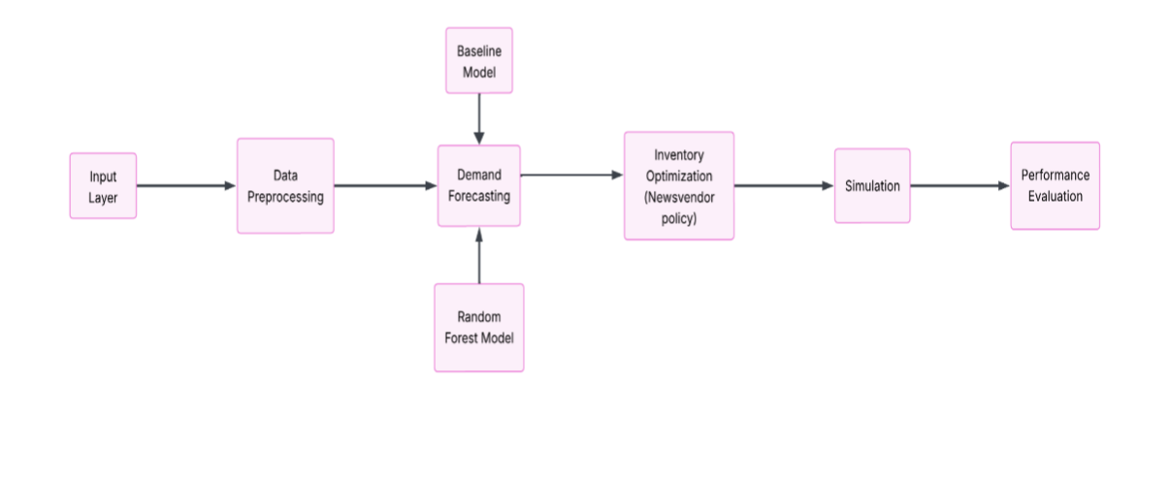
System Architecture

Slide 7
Dataset Design
90-day daily dataset
900 observations
Weekly seasonality and noise
69-day training, 14-day testing

Slide 8
Why Synthetic Data?
No access to real restaurant POS data
Synthetic data allows controlled experimentation
Patterns designed to mimic real behavior
Ensures reproducibility and transparency

Slide 9
How the Dataset Was Built
Generated 90 days of daily demand
Included weekly seasonality
Weekend and promotion effects added
Random noise models demand uncertainty

Slide 10
Feature Engineering Process
Converted raw demand into learning features
Lag variables capture recent history
Rolling averages smooth short-term noise
Calendar features encode weekday patterns

Slide 11
Demand Forecasting Approach
Baseline Forecast Logic:
• Uses demand from one week earlier
• Simple and transparent heuristic
• Represents common operational practice
• Serves as performance benchmark
Random Forest regressor:
• Works well with structured tabular data
• Captures non-linear relationships
• Robust with limited data
• Easy to interpret feature importance

Slide 12
AI Forecast Workflow
Train model on historical features
Generate daily demand predictions
Estimate forecast uncertainty
Pass forecasts to inventory decision model

Slide 13
Inventory Decision Philosophy
Objective:
• Determine optimal order quantity for each menu item
Method Used:
• Demand forecasting
• Newsvendor inventory optimization policy
Optimization Formula:
• Order Quantity = Forecast Demand + Safety Buffer
• Q = μ + zσ
Purpose:
• Reduce over-ordering
• Reduce stockouts
• Improve inventory efficiency

Slide 14
Handling Perishability
• Inventory tracked by age buckets
• Oldest units consumed first
• Expired items counted as waste
• New orders added as freshest stock

Slide 15
Simulation
Purpose of Simulation:
Evaluate inventory decisions
Simulation Steps:
Forecast demand
Calculate optimal order
Update inventory
Meet customer demand
Track waste and stockouts
Simulation Horizon:
14-day operational simulation

Slide 16
Why Simulation Instead of only Optimization?
Optimization alone:
• Assumes perfect conditions
• Does not capture real operational uncertainty
• Cannot evaluate daily inventory behavior
• Does not measure waste and stockouts over time
Simulation allows us to:
• Test inventory decisions in realistic conditions
• Model demand variability and uncertainty
• Track perishable inventory and food waste
• Evaluate daily supply chain operations
• Compare baseline vs AI-based decisions

Slide 17
Evaluation Metrics
• Fill rate: service performance
• Stockout rate: unmet demand
• Food waste percentage: sustainability
• Inventory turnover: efficiency

Slide 18
Limitations & Potential Extensions
Limitations:
• Synthetic demand data
• No supplier constraints modeled
• Fixed lead times and costs
Potential Extensions:
• Real POS data integration
• Multiple restaurants
• Weather and promotion effects

Slide 19
Conclusion
Project demonstrates end-to-end design
Emphasis on explainability and structure
AI used as decision support, not replacement
Foundation for more advanced systems
Thank you

